Slide 1
Play Sound using Directx
Prepared by: Mohammed Naggar
Department: IT
Section:2
Under supervision of: Dr. Khaled Hussien

Slide 2
Playing a wav
There are two types of buffers in DirectSound, a Stock Buffer object and Secondary Buffer object.
private Device device = null;
private SecondaryBuffer sound = null;
private BufferDescription desc;
device is our basic Directx device. I only reference the sound dll so its our sound device. And sound is our buffer that will hold and play our sound.

Slide 3
Next we move on to initializing Directx Sound.
Creates our device : device = new Device();
SetCooperativeLevel:- The application must set the cooperative level by calling this method before its buffers can be played.
device.SetCooperativeLevel(this, CooperativeLevel.Normal);
desc = new BufferDescription();
when I click on another window my wav player dont pause.
desc.GlobalFocus = true;

Slide 4
Load sound into our buffer
sound = new SecondaryBuffer("c:\\asd.wav", desc , device);
play the file
sound.Play(0, BufferPlayFlags.Default);
To Set the Position of the play cursor
sound.SetCurrentPosition(Position);
To get the Position of the play cursor
position = sound.PlayPosition;
To set or retrieve the attention of the sound
sound.Volume = volume; volume =sound.Volume;

Slide 5
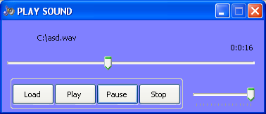
Application for play sound

Slide 6
To Play Wav File
We Press On The load Button .
The Open FileDialog Will Shown.
We Can Select the available wave file.
And then Press on The Play Button

Slide 7
The Pause Button To Pause The sound in Play.
The Stop Button To stop The sound and return from the begnning .
The TrackBar for change volume.
The TrackBar for change poition of sound during the sound is playing.

Slide 8
Thank You

